Slide 1

Global
Universities
Ranking
TITLE OF THE PROJECT

Slide 2



OUR TEAMS MEMBERS
DANDINA. RUPA DEVI NAGAMANI
21X41A4212
CHALAPATI. TEJASRI
21X41A4211
SINGAM. NAVYA SRI
21X41A4252
KOLLI. LAVANYA SRI VENKATA SARIKA
21X41A4226

Slide 3

Abstract
The global university rankings appeared in Order to measure the performances of higher education
institutions from all of the word after some Pre-established
indicators. The rankings make it possible to evaluate complex information according to various combinations of various factors. In this,we described and analyzed three of the most known, influential and widely observed international university rankings, in order to identify the similitudes and especially the differences between them regarding the methodology, criteria and weights, top universities, research and educational process or the global outlook, using the public and available in information from their web-sites.After the results of these rankings and others, all universities whether small or large, can improve practices that will make them stronger. For the contemporary society it is also important for a university to be able to innovate and help industry and businesses with consultancy and innovations.

Slide 4


Contents Of Table
01. Introduction
02. System Requirements
03. Architecture Of The Analysis
04. Advantages Of The Analysis
05. Libraries And Dataset
06. Visualization And Results
07. Conclusion & References

Slide 5



01. Introduction
A ranking represents a relationship between a set of items such that, for any two items,the first is either “ranked higher than”, “ranked lower than” or “ranked equal to” the second. In mathematics, this is known as a weak order or total preorder of objects. It is not necessarily a total order of objects because two different objects can have the same ranking.
In the current globalized economy, global university
rankings are used to measure their global competitiveness, being simultaneously criticised and lauded. Most of the
university rankings have been conducted by magazines,
newspapers, websites, governments, or academics. The
rankings cover at this moment only a small percentage
of approx. 2-3% of the total of universities.

Slide 6


02. System Requirements
Software Specifications
—> Language Used: Python
—> operating System: Windows 11
Mx n Hardware Specifications
—> Hard Disk: 512 GB
—> Processor: Intel(R) Core(TM)
—> Interpreter: Jupyter Notebook
(Anaconda)

Slide 7


03. Architecture Of The Analysis
Importing python libraries for analysis
Finding and reading the dataset
Getting a feel of dataset
Data cleaning
Grouping the data using different aspects of variables
Sorting the dataset by considering the most and least ranking universities(No.of students,no.of students
assigned to the staff,Female male ratio…..)
Aggregation Of numeric columns
Data Visualization: Visual plotting like histogram, barplot,pie charts on various numeric columns….etc
Relation between numeric columns using correlation of heatmaps

Slide 8


04.Goals Of The Analysis
To determine :
How many universities have greater than 10000 students ?
What are the top 10 universities based on rank?
What are the Universities that contain the maximum rate of international students?
Print the number of universities based on location?
Finding the maximum and minimum number of students' university records in the dataset ?
Grouping the Location column and getting United States Universities records.
By sorting the dataset, getting the university records based on the number of students.
How many universities have greater than 1000 students ?
How many universities have less than 1000 students ?
How many universities in India using bar plots?
What statistical metrics are computed for the columns 'number of students', ‘number of students per staff’ in the dataset.

Slide 9

05.Libraries And Dataset
Libraries Used For Analysis:
Pandas:
Pandas is a Python library used for working with data sets and is used for performing the manipulation operations.
Matplotlib:
Matplotlib is a popular Python library. It is used for data . visualizations like bar graphs,pie charts,histogram etc..
Numpy:
Numpy is a Python Library.It is used for converting the given
dataset into array to apply mathematical operations on it.
Seaborn:
Seaborn is a Python data visualization library based on matplotlib. It provides a high-level interface for drawing attractive and informative statistical graphics.

Slide 10
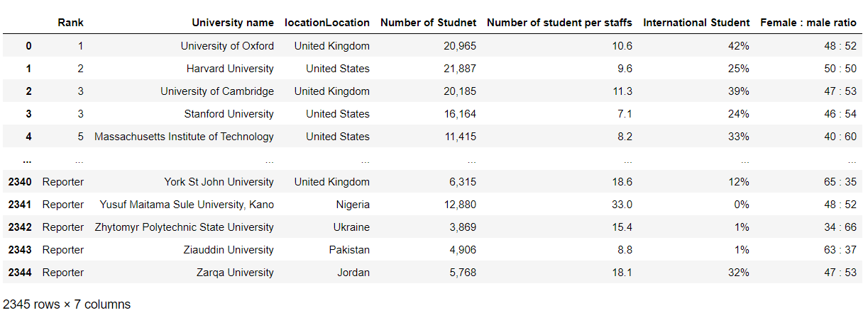
Dataset Used For Analysis :

Slide 11
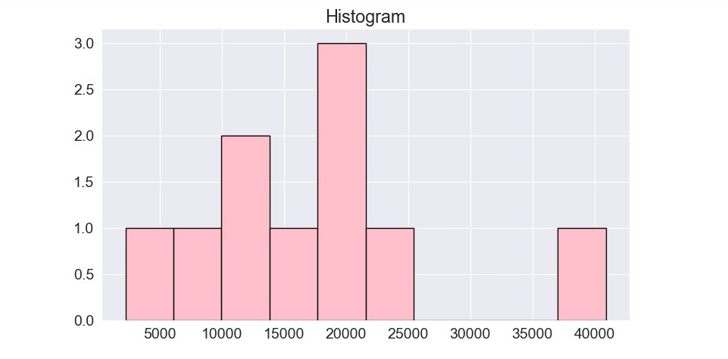
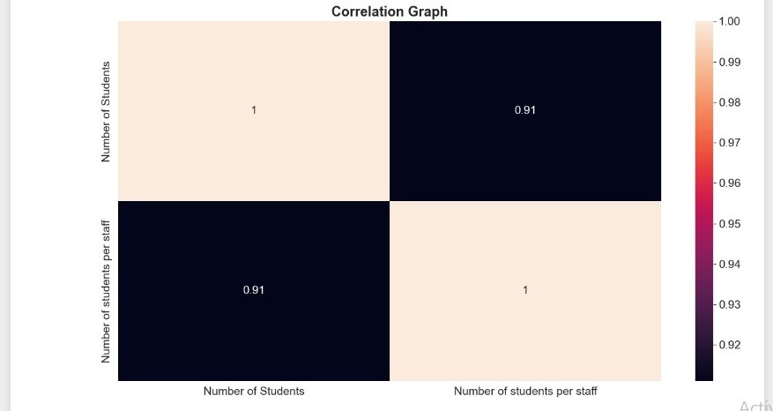
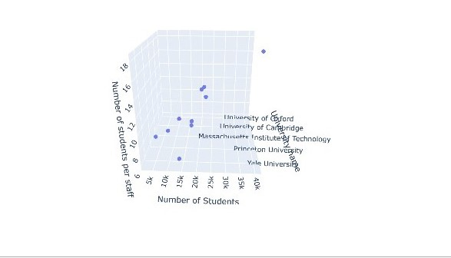
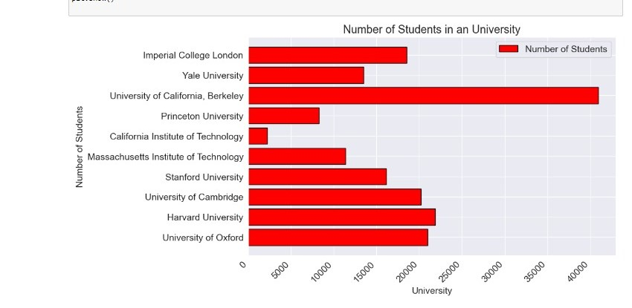
07. Visualization And Results

Slide 12

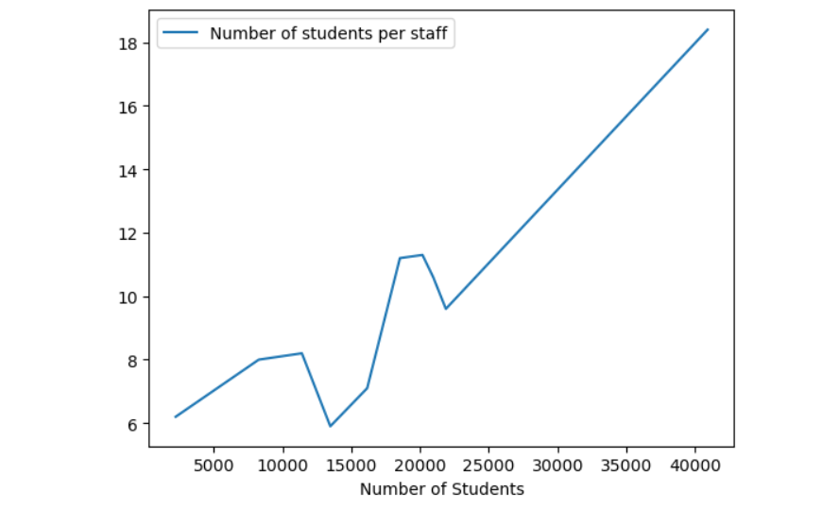
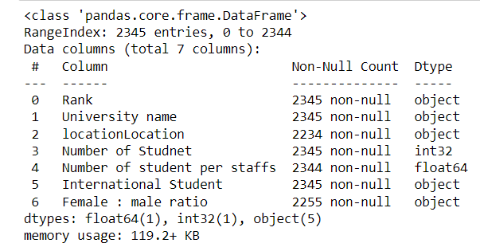
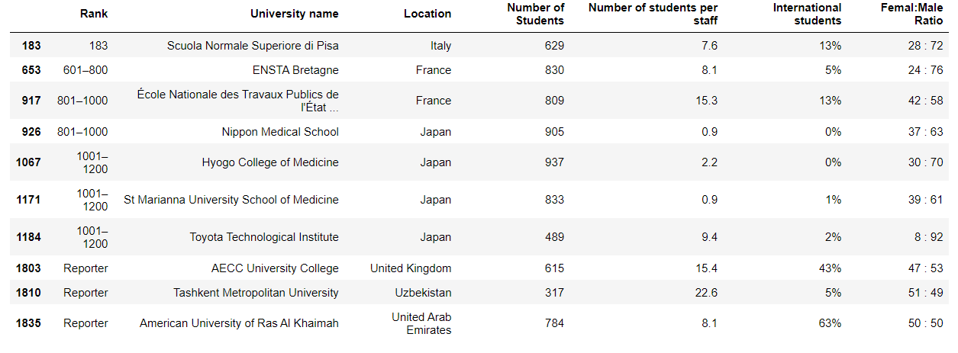
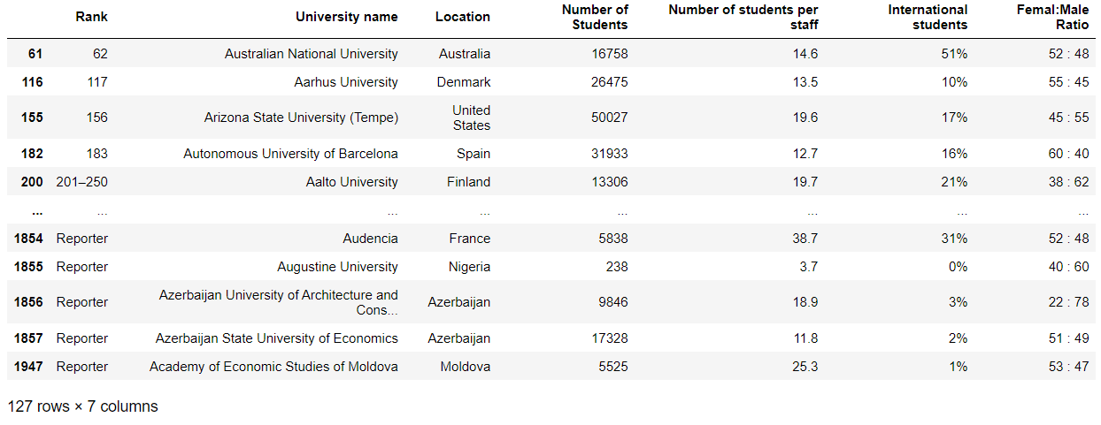
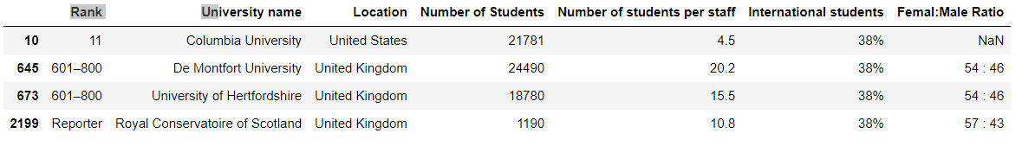

Slide 13

7. Conclusion And Reference Links
Conclusion
I have done very well in this internship. I have learnt very good skills which helps us in doing project and also in future. I have learnt a basic data analysis that boosts my confidence to learn more about data analysis and help to start my journey to learning data technologies using Python.
This type of project typically involves collecting and analyzing data related to the rankings that appear on University’s ranks section, which highlights universities that are currently popular and How the students are interested in joining in those universities.
This project can help in finding, measuring, analysing and comparing key aspects of World Universities Rankings. It’s a great experience and I am very much satisfied by learning these skills.
Reference Links
Kaggle: www.Kaggle.com
Slides go: www.Slidesgo.com

Slide 14


